Slide 1
Thelma J. Dudley Missionary Education Presentation For 2020-2021 Study Course Atlanta, GA Presenters - Ida P. Suggs & The Missionary Institute Directors Wednesday, February 26, 2020 8:40am – 10am

Slide 2
Special Thanks To…
Missionary Institute Directors
Nitra Threadgill….1st
Wanda Henry…2nd
Eleanor Ellis….3rd
Annie Williams…4th
Tiffanie E. Thompson….5th
Jacqueline Carter….6th
Rev. Carole Richardson….7th
Linda Woolridge….8th
Danette Armstead….. 9th

Slide 3
Objectives
Purpose
Overview of the Study Guide Books for 2020-2021
Adults
PHB
MEC
RTH
Additional Resources
Inter-web Series
Vision Boards
Goals for next year

Slide 4
Purpose Of the Mission
To identify and present books, pamphlets, brochures that are current and that provide information for every age group of the local church which is where the “study, the learning, discussion, sharing, and the understanding takes place.”

Slide 5
Adult Education Book Study Guide
Ages 36 and over

Slide 6
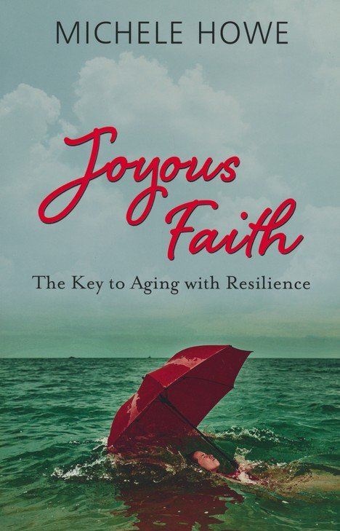
Adult Main Book #1
Joyous Faith: The Key to Aging with Resilience
Author: Michelle Howe
Description of Book: Joyous Faith is all about learning to navigate this uncertain season between midlife and old age with a robust faith, a sure hope, and a passion for life (even as bodies weaken and emotional, mental, and spiritual challenges continue to arise).
Reason why it was selected: It offers practical advice and spiritual encouragement to Christian women who are passing through the middle of life.
(Amazon & Christianbook.com); $8.99 - $10.99
Notes:
Joyous Faith: The Key to Aging with Resilience is beloved author Michele Howe’s newest resource for Christian women. It offers practical advice and spiritual encouragement to Christian women who are passing through the middle of life.
During the midlife season, women may find themselves feeling unmoored or untethered; and often unsure of what this season of life (and the next) will be like for them. How do they maintain a passion for life? How can you adventurously navigate the unique challenges that only middle-aged women face? Joyous Faith is all about learning to navigate this uncertain season between midlife and old age with a robust faith, a sure hope, and a passion for life (even as bodies weaken and emotional, mental, and spiritual challenges continue to arise). Thirty chapters written in true “Michele” style contain encouraging Bible passages and relatable real-life accounts, as well as practical guidance, sample prayers, a “take-away action thought,” and suggestions for stepping out in faith.

Slide 7
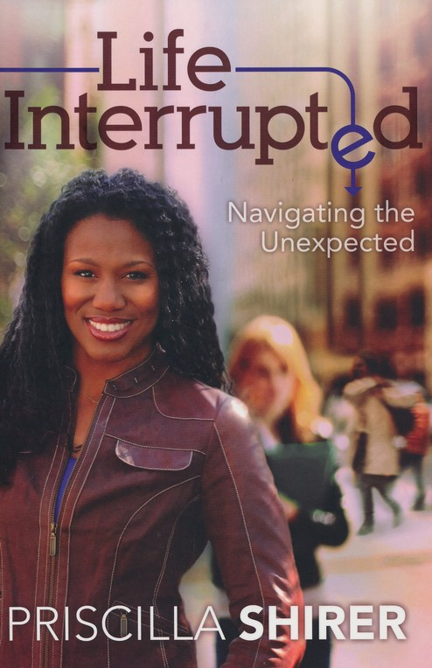
Adult Main Book #2 Life Interrupted: Navigating the Unexpected Author: Priscilla Shirer
Description of Book: Sharing the lessons she's learned, Priscilla Shirer reflects on the book of Jonah, showing you how to experience the freedom that comes from going with God - even when the world seems to be against you.
Reasons why it was selected: Reflection to the reader…Intrusions from outside invade our lives daily. Is it possible they might be opportunities from God?
(Amazon); $8.99
Notes:
Intrusions from outside invade our lives daily. Is it possible they might be opportunities from God? Sharing the lessons she's learned, Priscilla Shirer reflects on the book of Jonah, showing you how to experience the freedom that comes from going with God - even when the world seems to be against you. Paperback.

Slide 8
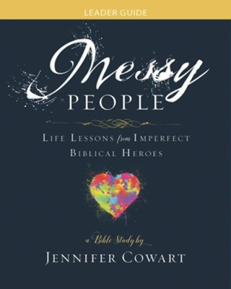
Adult Main Book #3
MESSY PEOPLE- God Can Turn Your Mess Into A Masterpiece
Author: Jennifer Cowart
Description of the Book: We will dig into the lives of biblical heroes who were messy people just like us but who were used by God in powerful ways. Together we will examine the stories of five wonderful but messy people and one messy parable character: Rahab, the Prodigal Son, Josiah, Mary, David, and Daniel.
Reasons why it was selected: From their stories, we will learn how God can use broken people, restore damaged hearts and relationships, give us power to handle our critics, and help us deal with the hard moments of life.
~ $11.49
Notes:
Every life gets messy at times. Sometimes these messes are literal, like a house that would be easier to condemn than to clean. But sometimes they are intangible messes such as illness, conflict, depression, abuse, bankruptcy, divorce, and job loss. And these messes can be painful, hurting our hearts and our homes. But as we see in the Bible, God loves to use messy people!
In this six-week study, we will dig into the lives of biblical heroes who were messy people just like us but who were used by God in powerful ways. Together we will examine the stories of five wonderful but messy people and one messy parable character: Rahab, the Prodigal Son, Josiah, Mary, David, and Daniel. From their stories, we will learn how God can use broken people, restore damaged hearts and relationships, give us power to handle our critics, and help us deal with the hard moments of life. Along the way we’ll discover that we don’t have to just endure messy lives but can actually learn to thrive with God’s guidance and help. In the hands of God, our messes can become His masterpieces!
The Leader Guide, to be used along with the study's workbook and DVD, contains six session plan outlines, complete with discussion points and questions, activities, prayers, and more—plus leader helps for facilitating a group.

Slide 9
Phyllis H. Bedford Education Book Study Guide
Young Adults 18 – 35

Slide 10
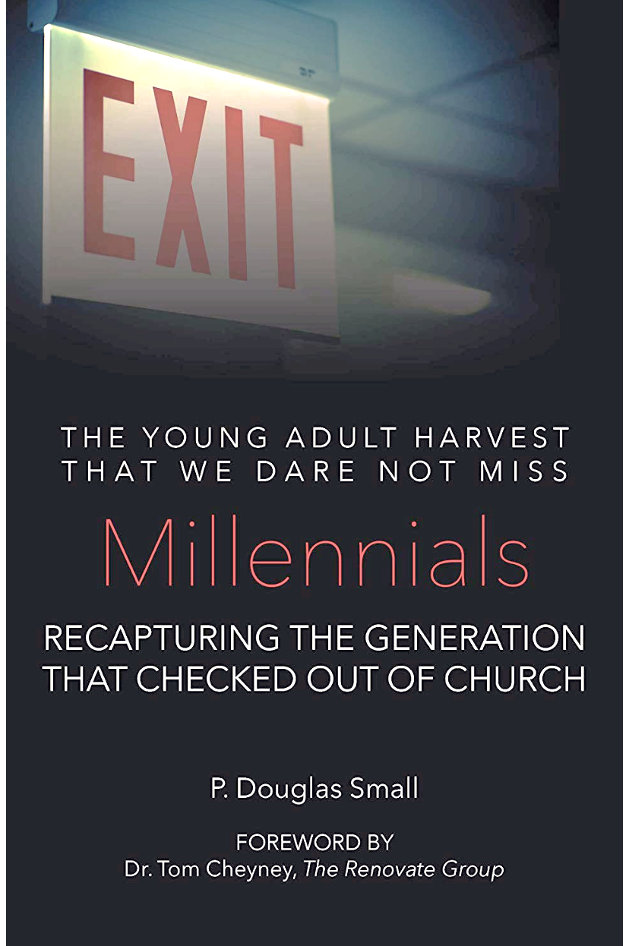
Phyllis H. Bedford Main Book #1
Millennials-Recapturing the generation that checked out of church
Author: P. Douglas Small
Description of the Book: Without a spiritual awakening that captures the attention of the Millennials and see a significant number of them converted and swept into the kingdom of God, and as a result, the entire culture reengaged with the gospel, the current senior generation will pass away leaving Christian churches in the nation virtually empty. Only God can heal the divide and reclaim the current generation!
(Amazon) $14.99
Notes:
Description: Without a spiritual awakening that captures the attention of the Millennials and see a significant number of them converted and swept into the kingdom of God, and as a result, the entire culture reengaged with the gospel, the current senior generation will pass away leaving Christian churches in the nation virtually empty. Only God can heal the divide and reclaim the current generation!

Slide 11
Phyllis H. Bedford Main Book #2
Reaching Young Adults-Equipping, Empowering and Energizing your Church for the Future
Dr. Richard C. Flippin
Looking for a tried and tested to attract more young adults to your ministry? Dr. Flippin tells a compelling story of a historic church making changes to meet new times and to develop a new generation of leaders. Trust the wisdom and research of Dr. R. C. Flippin, Empower and Energize your young adult ministry.
(Amazon) $9.95
Notes:
Looking for a tried and tested to attract more young adults to your ministry? Dr. Flippin tells a compelling story of a historic church making changes to meet new times and to develop a new generation of leaders. Trust the wisdom and research of Dr. R. C. Flippin, Empower and Energize your young adult ministry.
Paperback……….$9.95

Slide 12
Mattie E. Coleman Educational Book Study Guide
Ages 12-17

Slide 13
Mattie E. Coleman Main Book # 1
The Power of a Praying Teen
Author: Stormie Omartian
Description of the Book: Teens discover how learning to pray can change everything. Twenty typical chapters reveal how to have a closer walk with God, say goodbye to negative emotions, attract good relationships, rise above peer pressure and be a light for others.
They will learn to talk with God, hear from God and see His great purpose for them unfold.
Updated for today’s teens with focus on purity, peer pressure, insecurity, body/self –image, friendships and more.
~ $8.49-12.00* depends of where you purchase

Slide 14
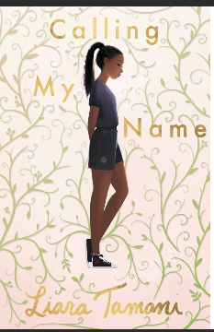
Mattie E. Coleman Main Book # 2
Calling My Name
Author: Liara Tamani
Description of the Book: Calling My Name tells the coming-of-age story of an African American girl named Taja Brown growing up in a devout family in Houston, Texas. In fifty-three iridescent short chapters, Taja narrates her teenage years—from middle school to high school graduation—as she struggles to figure out life, love, and her own brand of spirituality. Taja’s deeply felt voice, coupled with Liara Tamani’s elegant and literary style, delivers a generous and thematically rich emotional wallop.
$6.00-13.00
Notes:
Calling My Name tells the coming-of-age story of an African American girl named Taja Brown growing up in a devout family in Houston, TX. Taja narrates her teenage years---from middle school to high school graduation—as she struggles to figure out life, love, and her own brand of spirituality.
Family, sisters, friends, enemies, neighbors, school, church, first love, expectations, betrayal, hopes, dreams…Who and what do you listen to? How do you stay true to yourself, when everyone is telling you something different about who to be?

Slide 15
Mattie E. Coleman Main Book # 3
Wonderful: The Truth About Who I Am
Author: Stephen Kendrick, Alex Kendrick, with Amy Parker
Description of the Book: This book is written for kids ages 8 to 12 years as they are discovering their true selves. This book focuses middle-grade readers to focus their identity right back to where it belongs: on their hearts and souls and minds, reflecting the glory of the One who made them. Featuring full-color illustrations, each short essay and activity will help kids discover their worth in God and learn that their true identity is nothing short of wonderful. Softcover edition.
$10-15
Notes:
Calling My Name tells the coming-of-age story of an African American girl named Taja Brown growing up in a devout family in Houston, TX. Taja narrates her teenage years---from middle school to high school graduation—as she struggles to figure out life, love, and her own brand of spirituality.
Family, sisters, friends, enemies, neighbors, school, church, first love, expectations, betrayal, hopes, dreams…Who and what do you listen to? How do you stay true to yourself, when everyone is telling you something different about who to be?

Slide 16
Rossie T. Hollis Education Book Study Guide
Young Adults 0– 11

Slide 17
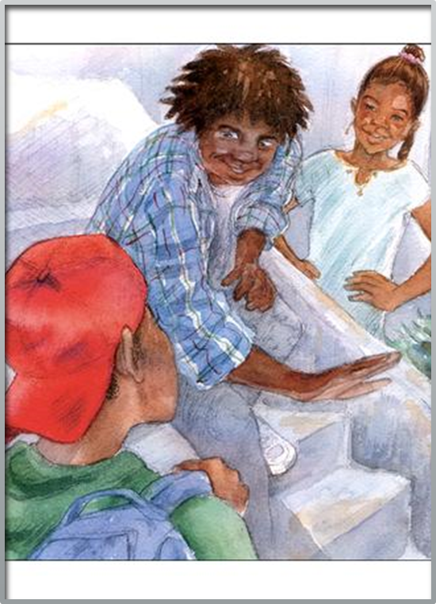
Rossie T. Hollis Main Book # 1
I HAVE A DREAM, TOO!
Author: Jean Alicia Elster
Description of the Book: Serious minded Joe Joe faces friends who ridicule him for dreaming of going to college someday. While searching for answers, Joe Joe discovers a book about Mary McLeod Bethune, an influential African American woman who overcame poverty and illiteracy at an early age to start a college and become a government worker for the Franklin D. Roosevelt administration Joe Joe realizes that attaining his goal won’t be easy but encouraged by his family and his faith, he chooses to pursue his dream in spite if peers who mock him.
$10.99
Notes:
Follow ten-year-old Joe Joe Rawlings as he faces contemporary challenges with guidance gleaned from a rich cast of historical characters in this series of books written around Christian themes for African American children, ages 6-10. Joe Joe in the City deals in a realistic but age-appropriate manner with issues and challenges facing African American children and their families in an urban environment.
In this second installment, I Have a Dream, Too!, the serious-minded but likable Joe Joe faces friends who ridicule him for dreaming of going to college someday. While searching for answers, Joe Joe discovers a book about Mary McLeod Bethune, and influential African American woman who overcame poverty and illiteracy at an early age to found a college and become a government worker for the Franklin D. Roosevelt administration. Joe Joe Realizes that attaining his goal won't be easy either, but encouraged by his family and his faith, he chooses to pursue his dream in spite of peers who mock him.

Slide 18
Rossie T. Hollis Main Book # 2
I Am Enough
Author: Grace Byers
Description of the Book: This is a gorgeous, lyrical ode to loving who you are, respecting others, and being kind to one another. We all are here for a purpose. We are more than enough. We just need to believe it.
$10
#1 Best Seller in Children’s Bullies Issues Books

Slide 19
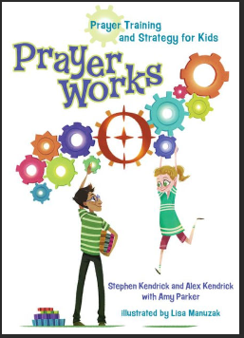
Rossie T. Hollis Main Book # 3
Prayer Works: A Prayer Strategy
for Kids
Author: Alex Kendrick, Stephen Kendrick, and Amy Parker
Description of the Book: This companion book to the movie War Room is engaging way to get children ages 8 to 12 to grow in their prayer life. Lots of great explanations are combined with fun activities.
$10

Slide 20
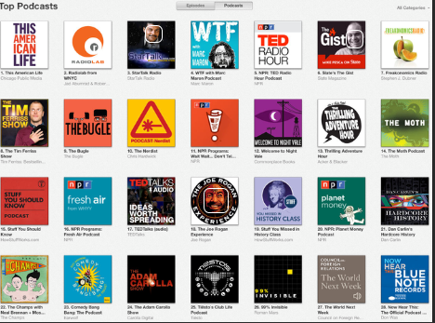
“New”-age Supplemental Material/Resources
Study Guides have an overall theme of:
Growth, Development, Acceptance, Perseverance & Reflection
New-age supplemental materials that could engage the newer generation while opening the eyes of the more seasons ones ☺
Podcasts
Inter-web Series:
Tedtalks
Red Table Talk
YouTube
Self-help activities
Puzzles
Vision Boards
Notes:
Today we will talk briefly talk about Tedtalks and Vision Boards

Slide 21
Interweb Series: TED Talks
Brene Brown discusses the power of Vulnerability, June 2010 in Houston Texas
https://www.ted.com/
Notes:
*We won’t watch this video right but I will encourage you to watch it on your on later. However I will give you some background on how you could use it or something like it in the future to help continue/ extend the conversation from our guided readings.
https://www.ted.com/
About TED
TED is a nonpartisan nonprofit devoted to spreading ideas, usually in the form of short, powerful talks. TED began in 1984 as a conference where Technology, Entertainment and Design converged, and today covers almost all topics — from science to business to global issues — in more than 110 languages. Meanwhile, independently run TEDx events help share ideas in communities around the world.
With some of the TED videos, we can continue to share and talk about common topics and themes discussed in our books to help us keep the conversation going.
After watching the video, prompt questions like:
How the theme in _____________________(book/ chapter) connect to Brene Brown power of vulnerability?
Did this video bring up anything for you?

Slide 22
Vision Boards
HOW CAN THEY HELP YOU ACHIEVE YOUR GOALS? In five ways: They:
√ Serve as a great visual reminder of what it is you truly want.
√ Drive the message about what it is you want deep into your subconscious mind.
√ Program the reticular activating system in your brain to notice resources that will help you achieve your goals – resources that you hadn't noticed before.
√ Attract to you the very resources and people that you need to achieve your goals.
√ Motivate you to take action to achieve your goals.
Notes:
A VB is a tool that thousands of people across the world have used successfully as part of their goal setting process to help them be, have or do whatever they want. The launch of the New York Times Bestseller “The Secret” has made this tool even more popular today.
The concept derives from the practice of visualization – the art of creating clear, colorful and compelling pictures in your mind of exactly what it is you want.
In the same way that you can visualize just one goal or spend time visualizing all your goals, the same is true in creating your board. Rather than being a picture of your goal or goals in your mind’s eye, it is a hard copy, physical picture.
Please continue to use this as supplemental material as well. As you continue to read, you will want to work on yourself, relationships, and community. Vision boards will be an excellent way for you to put your new goals down on paper.

Slide 23
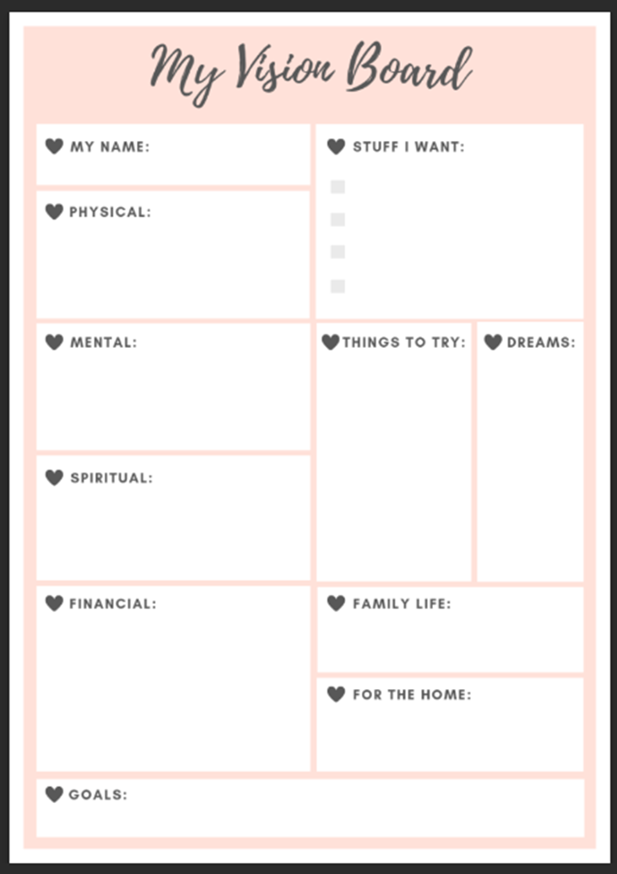
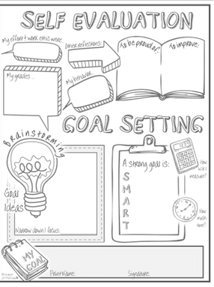
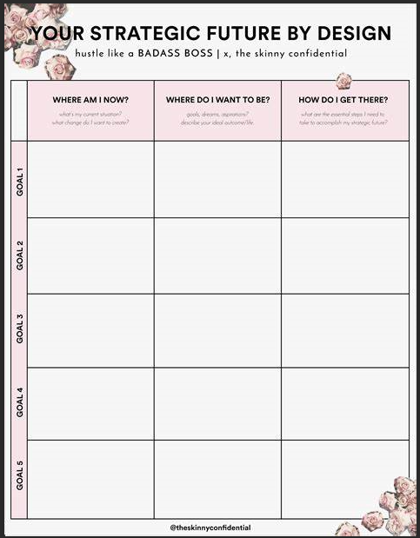

Slide 24
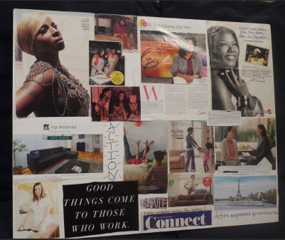
Examples ☺

Slide 25
Goals for the Next Year
Literature to have:
More African American and Women Authors
Please feel free to email any book suggestions that you have to: ida.suggs@att.net
Continue to discover and use supplemental materials
Allows us to continue to further our discussions and share with one another
Connect with the younger generations and/or member of our congregation(s).

